Slide 1
Efficiency of Recursive Algorithm
Time complexities of recursive algorithm
Presented by: kristina udash
Presented to: Saroj Poudel

Slide 2
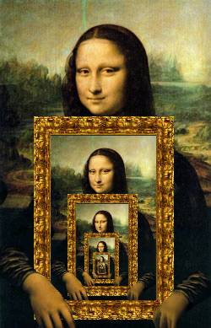
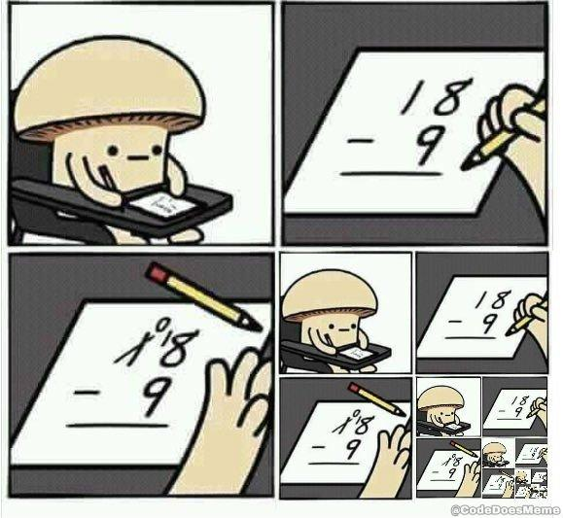

Slide 3
Contents of This Template
What is recursion?
What is efficiency?
Examples of recursion and their time complexity

Slide 4
Recursion
Definition
Properties
Examples

Slide 5
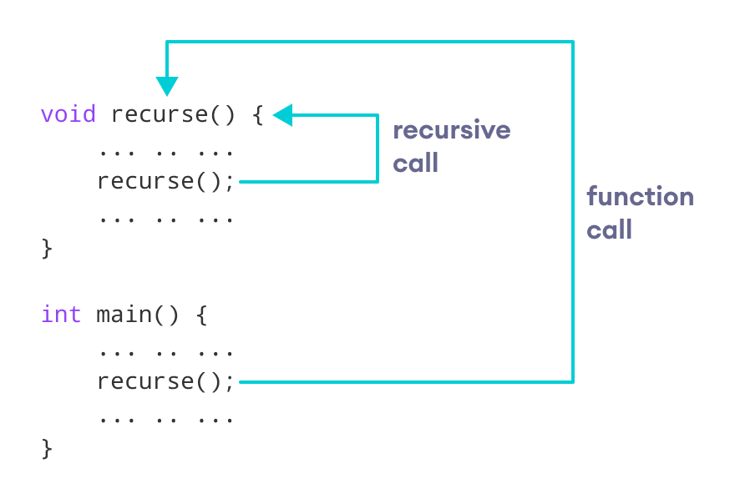
Recursion
The process in which a function calls itself
approach(1) – Simply adding one by one
f(n) = 1 + 2 + 3 +……..+ n
approach(2) – Recursive adding
f(n) = 1 n=1
f(n) = n + f(n-1) n>1

Slide 6
Properties of Recursion
A recursive function can go into infinite loop
To avoid, there are two properties that recursive functions must have:
Base criteria: there must be at least one base criteria or condition such that when this condition is met the function stops calling itself
Progressive approach: the recursive calls should progress in
such a way that each time a recursive
call is made it comes closer to the
base criteria

Slide 7
int test(n) { if(n>1) { cout<<n; test(n-1); } else return 1; } int main{ test(3); }
Test(3)
3
Test(2)
2
Test(1)
1

Slide 8
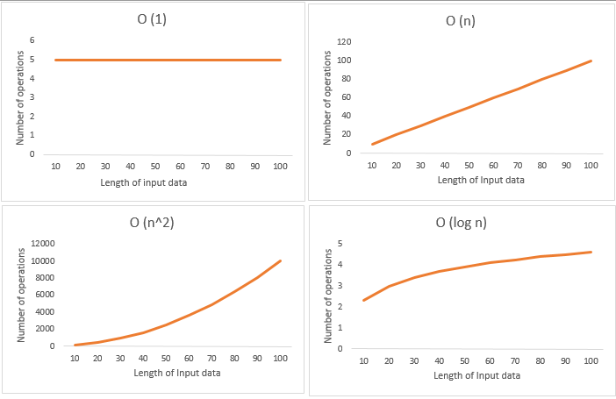
Time complexity
Amount of time required by an algorithm to run
It measures the time taken to execute each statement of code in an algorithm

Slide 9
Test(3)
1
3
Test(2)
2
2
Test(1)
3
1
The function is executed 3 times when n = 3
It will be executed 5 times when n = 5
So, it will be executed n times when we put the value of n
Time can be represented as O(n) = n

Slide 10
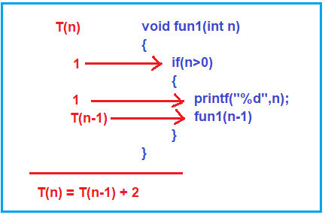
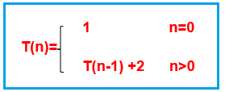
Time complexity of recursion using recurrence relation
We take T(n) as total time taken by the statements to execute within the function
T(n) = T(n-1) + 2 when n > 0

Slide 11
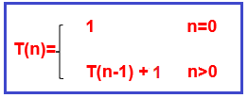
Induction method / Successive Substitution method
If we have any constant value, then we have to write it as 1
T(n) = T(n-1) + 1 ---------- eq 1
T(n-1) = T(n-2) + 1
T(n) = T(n-2) + 2 --------- eq 2
T(n) = T(n-3) + 3 ---------- eq 3
T(n) = T(n-k) + k ---------- eq 4
We have to reduce it to n = 0, so when n-k = 0
n = k
T(n) = T(n-n) + n
T(0) + n
1 + n
T(n) =1 + n
O(n) = n

Slide 12
Examples of recursion functions
Example | Recurrence relation | Time complexity
Binary search | T(n) = T(n-2) + O(1) | O(logn)
Linear search | T(n) = T(n-1) + O(1) | O(n)
Merge sort | T(n) = 2T(n/2) + O(n) | O(n logn)
Selection sort | T(n) = T(n-1) + O(n) | O(n^2)
Towers of Hanoi | T(n) = 2T(n-1) + O(1) | O(2^n)
Fibonacci series | T(n) = T(n-1) + T(n-2) + O(1) | O(2^n)

Slide 13
Resources
https://www.geeksforgeeks.org/recursion/
https://www.javatpoint.com/recursion-in-c
https://www.enjoyalgorithms.com/blog/time-complexity-analysis-of-recursion-in-programming
https://dotnettutorials.net/lesson/time-complexity-of-recursive-function/

Slide 14
Thank You I hope you have a very good day

